Slide 1


GIT Assignment
Presented By : Gulshan Singh

Slide 2

Agenda
What is GIT?
Why we use GIT?
WorkFlow of GIT
Learn about Cherry-Pick Command

Slide 3
What is Git ?
GIT is a version controlled system which you can use to maintain code for your project.
It helps you to save your project at different versions, so that you can retrieve a previous version of your project without any problem. Source codes(or files) are saved in repositories.
You check out the files from a version, make some changes, save it and commit changes to create a newer version of your project.
Trusted
Innovative
Popular
GitHub is committed to developer privacy and provides a high standard of privacy protection to all our developers and customers.
Switching from a centralized version control system to Git changes the way your development team creates software.
Git is very popular among open source projects.

Slide 4
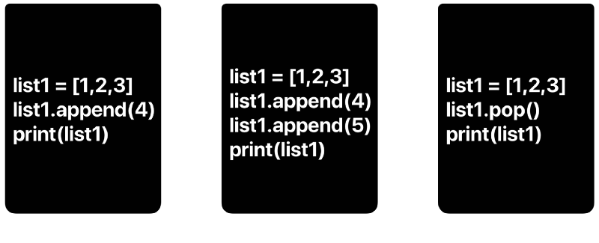
Why We Use GIT?
The version control system has the following benefits:
• You have access to all versions of all files in Git repository at any time, it’s almost impossible to lose any part of a code.
• Multiple developers can work on one project at the same time without interfering with each other, and without fear of losing any changes made by a colleague. In Git, the possibilities of collaborative work are unlimited.
You will have to use Git every day, and this is a tool you should have a perfect command of.
Be sure to sign up on GitHub or Bitbucket. These services offer great manuals on how to start working with remote repositories. I like bitbucket for the possibility of creating unlimited number of private repositories.

Slide 5
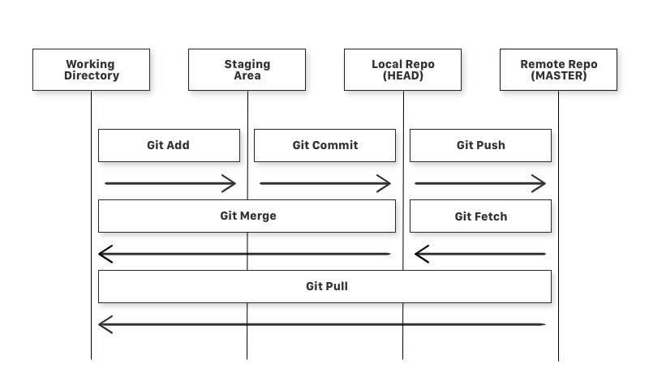
What is a Repository ?
A repository a.k.a. repo is nothing but a collection of source code.
There are four fundamental elements in the Git Workflow.
Working Directory, Staging Area, Local Repository and Remote Repository.

Slide 6
GIT COMMANDS
git add - is a command used to add a file that is in the working directory to the staging area.
git commit - is a command used to add all files that are staged to the local repository.
git push - is a command used to add all committed files in the local repository to the remote repository. So in the remote repository, all files and changes will be visible to anyone with access to the remote repository.
git fetch - is a command used to get files from the remote repository to the local repository but not into the working directory.
git merge - is a command used to get the files from the local repository into the working directory.
git pull - is command used to get files from the remote repository directly into the working directory. It is equivalent to a git fetch and a git merge .

Slide 7

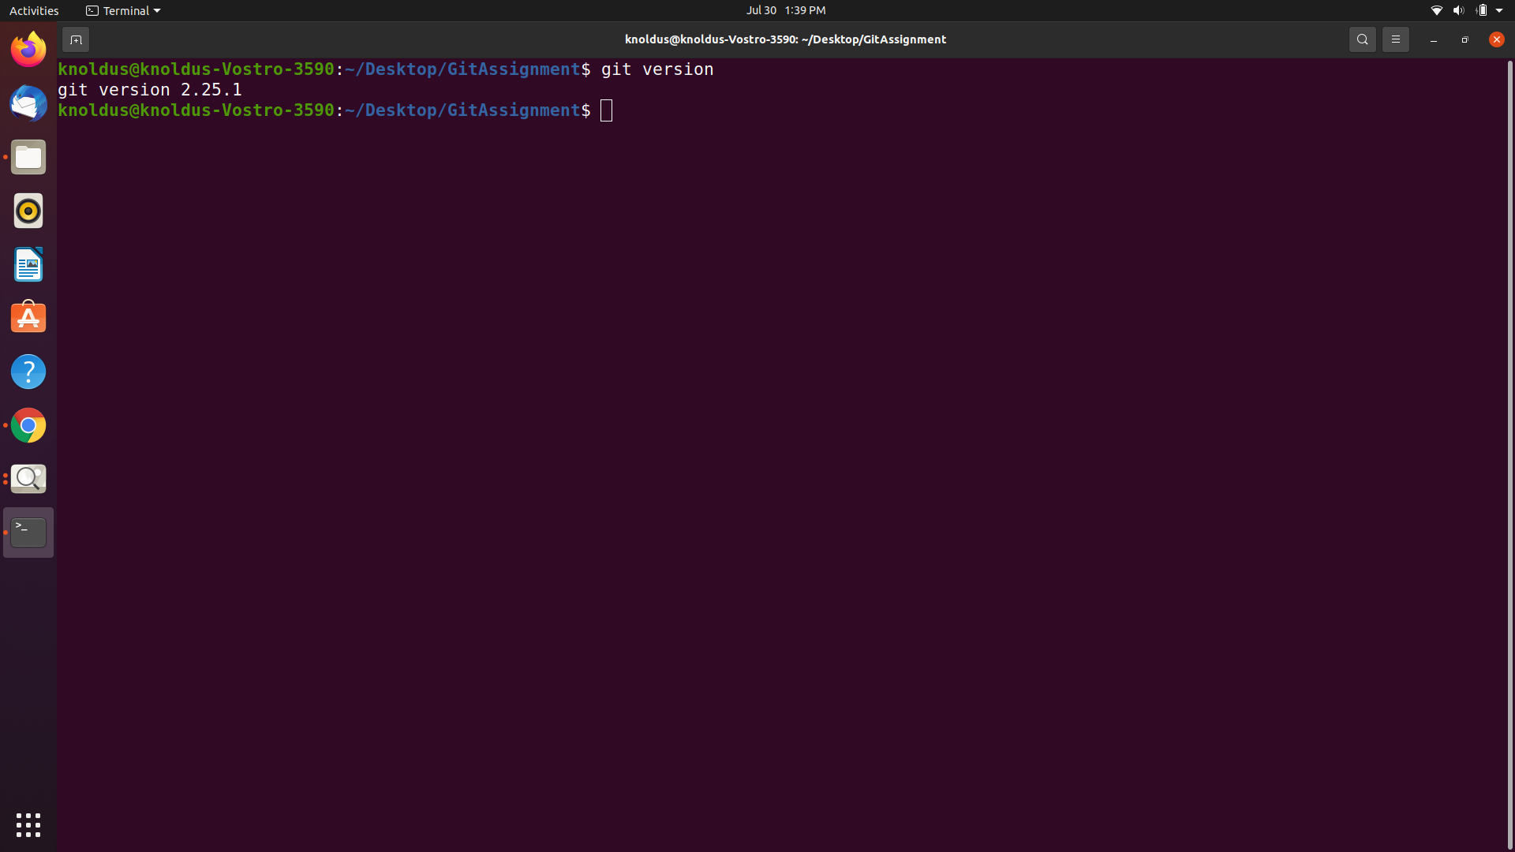

Hands on GIT Commands
Firstly Make a GitHub Account
Make sure you have Git installed on you machine.
Check the version
git --version

Slide 8
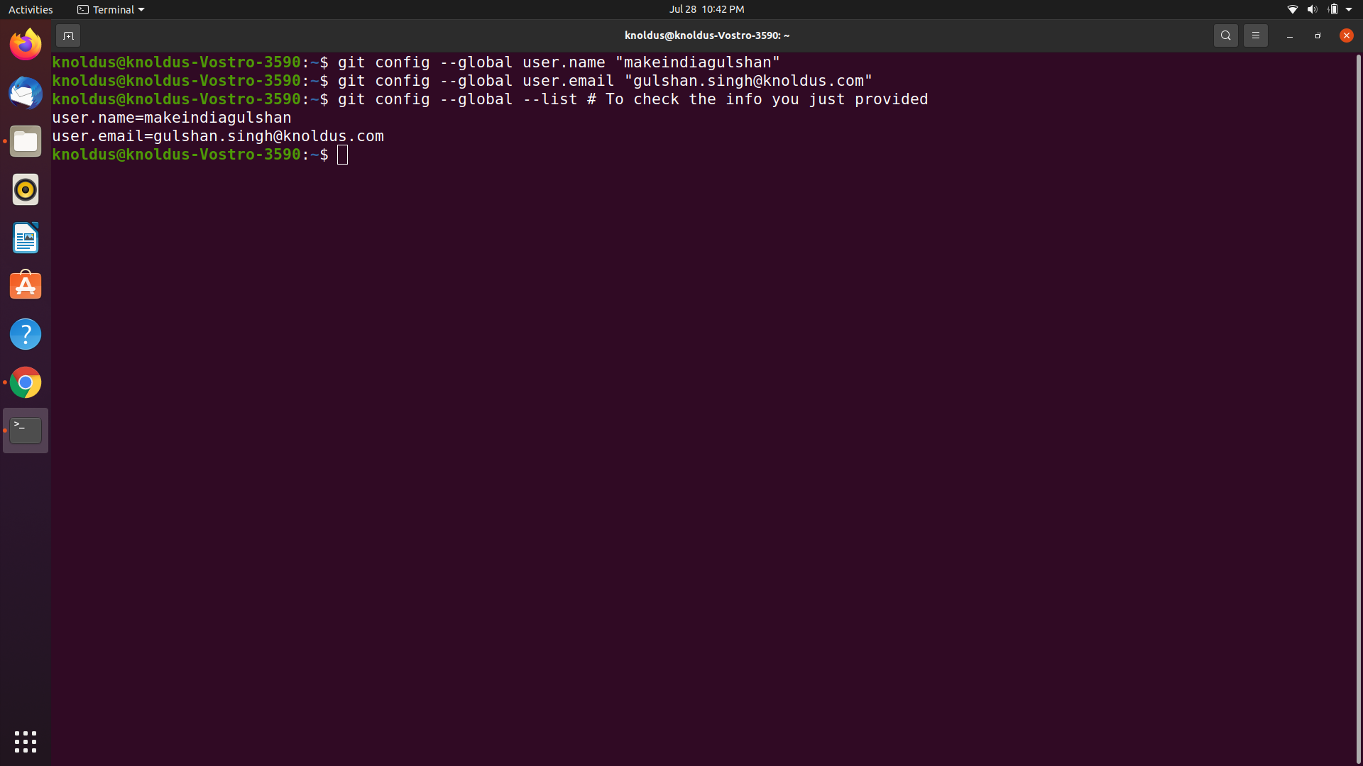
Tell Git who you are
$ git config --global user.name "YOUR_USERNAME"
$ git config --global user.email "im_satoshi@musk.com"
$ git config --global --list # To check the info you just provided

Slide 9

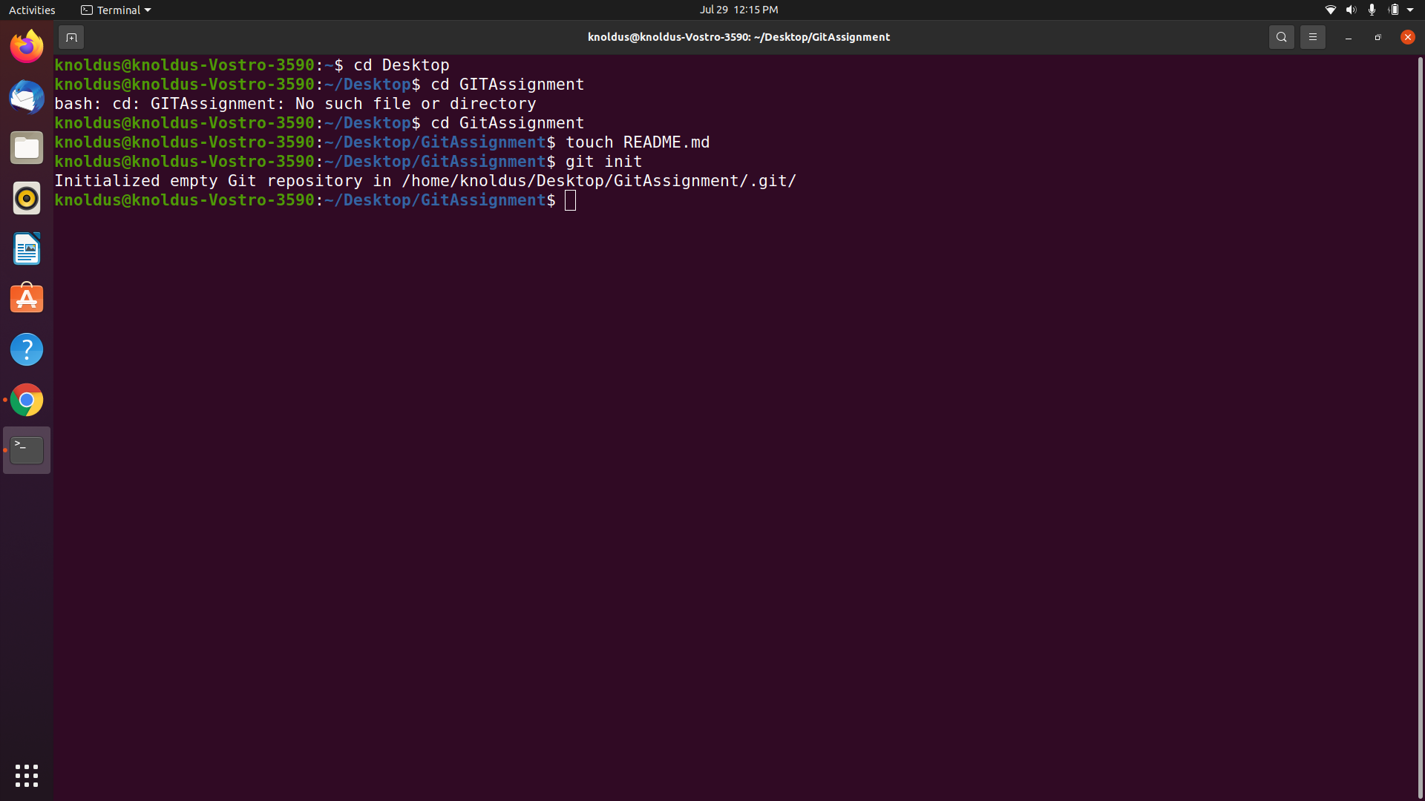
Let’s Git
Create a new repository on GitHub
Now, locate to the folder you want to place under git in your terminal.
$ cd Desktop/GITAssignment
Initialize Git:
And to place it under git, enter:
- $git init
-$ touch README.md # To create a README file for the repository$ git init

Slide 10
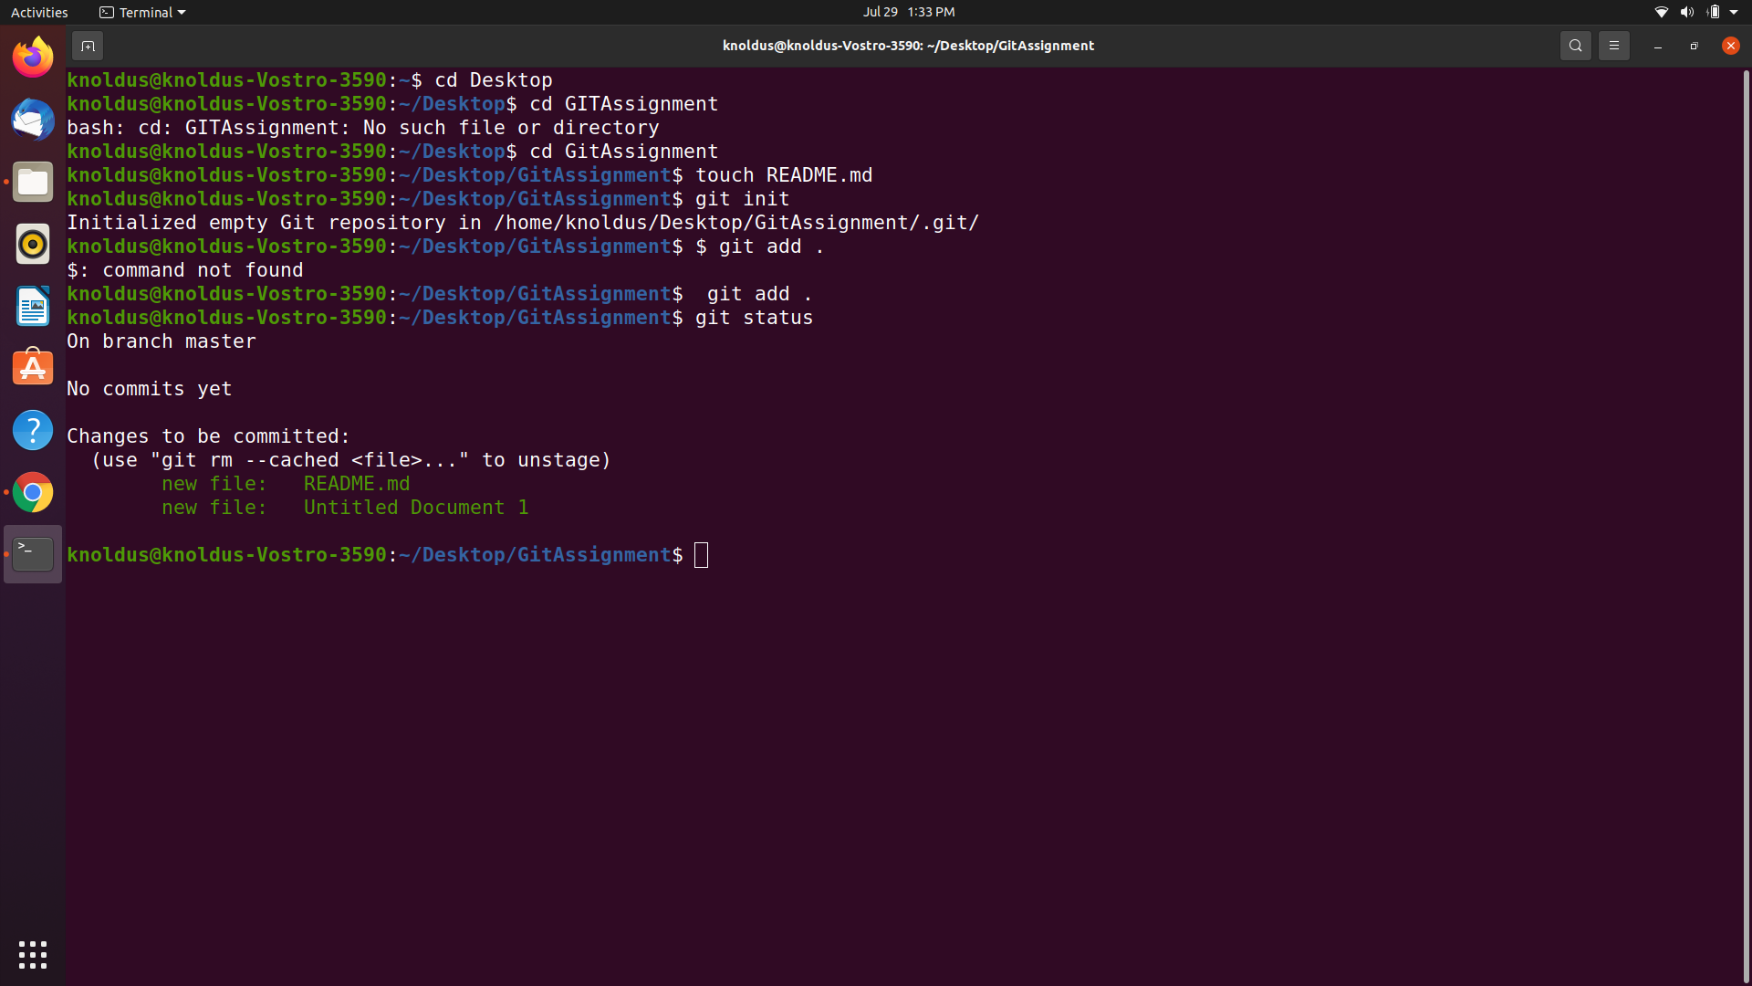
Add files to the Staging Area for commit:
Now to add the files to the git repository for commit:
$ git add . # Adds all the files in the local repository and stages them for commit
OR if you want to add a specific file
$ git add README.md # To add a specific file
Before we commit let’s see what files are staged:
$ git status # Lists all new or modified files to be committed

Slide 11
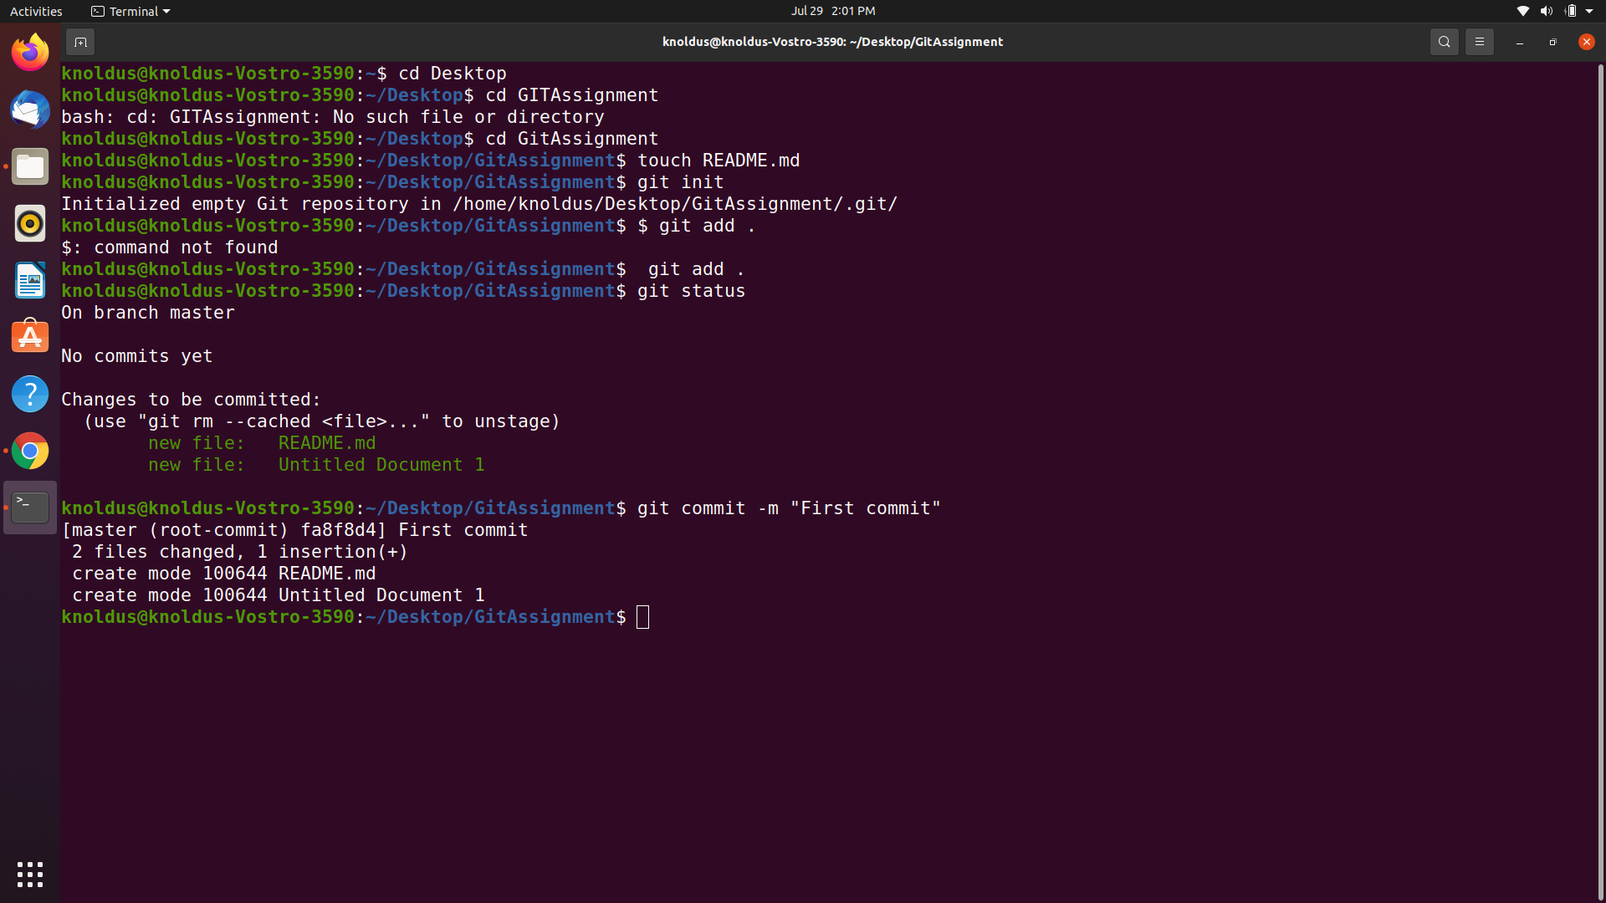
Commit Changes you made to your Git Repo:
$ git commit -m "First commit" # The message in the " " is given so that the other users can read the message and see what changes you made

Slide 12
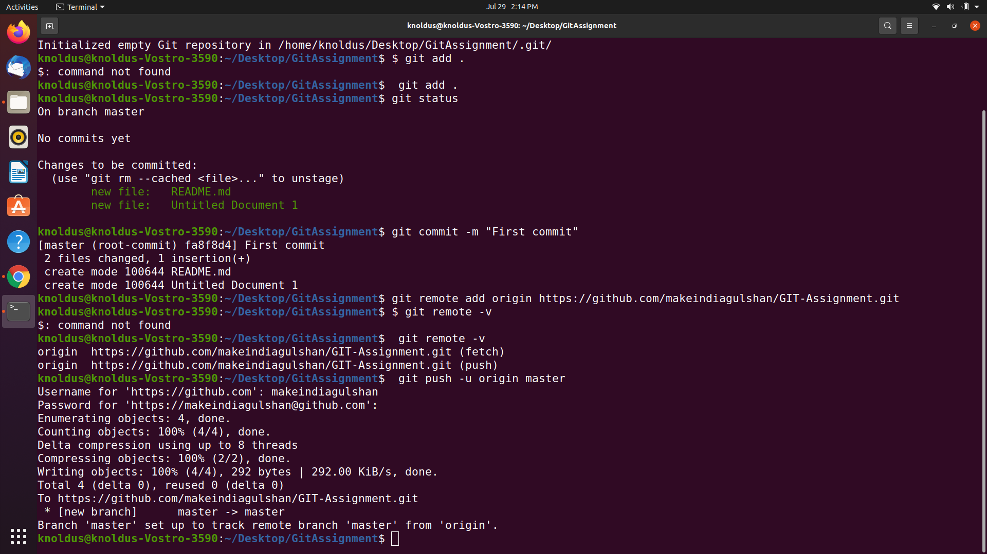
Add a remote origin and Push:
$ git remote add origin remote_repository_URL # sets the new remote
The git remote command lets you create, view, and delete connections to other repositories.
$ git remote -v # List the remote connections you have to other repositories.
The git remote -v command lists the URLs of the remote connections you have to other repositories.
$ git push -u origin master # pushes changes to origin
Now the git push command pushes the changes in your local repository up to the remote repository you
specified as the origin.

Slide 13
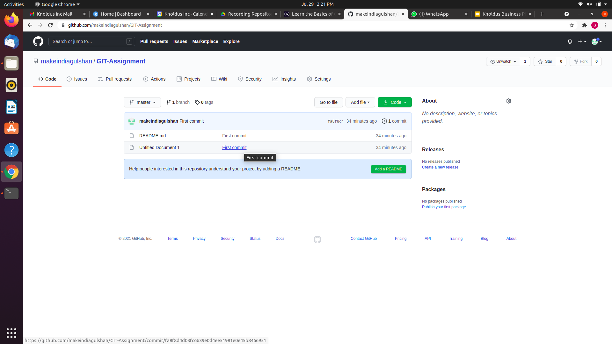
Repository page on GitHub

Slide 14


The Git Cherry Pick Command
The git cherry-pick command applies the changes introduced by some existing commits
Let's say two developers working on a feature, each developer working on separate task relate to the feature on two different branches and commit it once the task has been done. At the end of the day, they need to merge both the task together and merge it with master branch. In this case, we pick one of the developer commit by copy it's commit ID got from git log command and navigate it to another developer branch and using the following command git cherry-pick <copied-commit-id> apply the changes in the commit to the current developer branch.

Slide 15
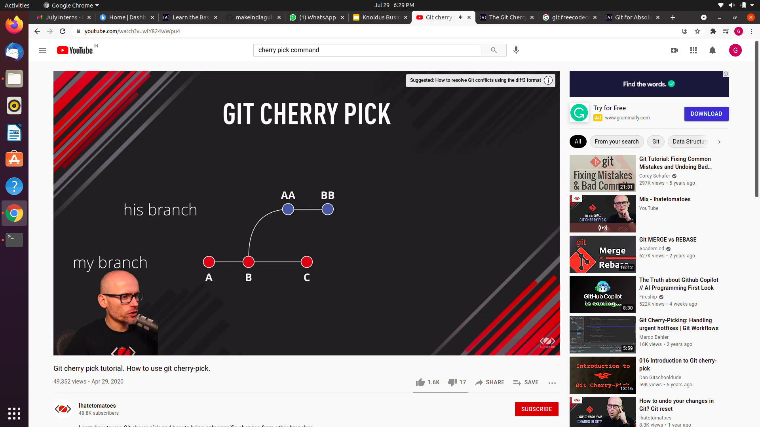
Use of ‘git cherry-pick’
You may need to resolve conflicts to fully apply the changes from the given commit. This could be averted by doing a git cherry-pick.
This could also be useful whenever a full branch merge is not possible due to incompatible versions in the various branches.
Also, you can use git cherry-pick to pull the changes introduced to a sub-branch, without changing the branch, by your colleague working on the same project.

Slide 16

Hands on cherry-pick command
First i create new branch name feature-readme-instructions
Create two files test1.txt and test2.txt in that branch
Then add it by git add . command to local repository
Commit both the files test1.txt and test2.txt on the repository by $ git commit -m "First commit"
command
Then push the files on the remote repository by the following command
$ git remote add origin github.com/makeindiagulshan/GIT-Assignment
Use the cherry-pick command git cherry-pick commitID
It will only commit the mention commitID to the main branch not like merge command which will merge all the commits

Slide 17
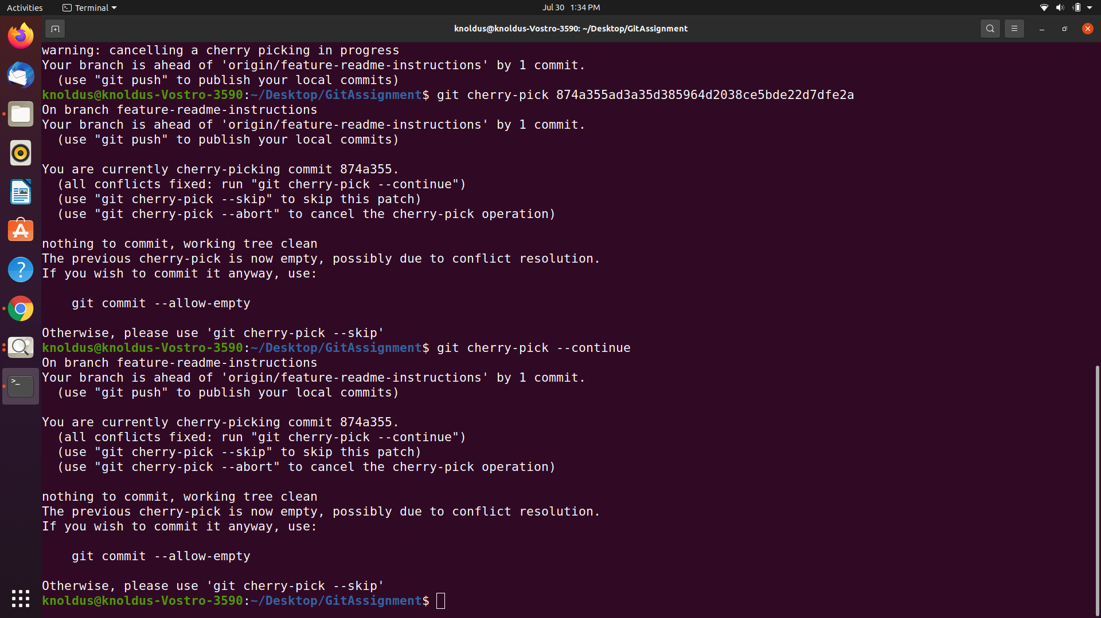

Slide 18
GITHUB URL
https://github.com/makeindiagulshan/GIT-Assignment

Slide 19
Thank You!
Stay in Touch
facebook.com/templateparade
@Temparade
Boulevard of Good Dream, 89898
+6288 2546 0845

